Slide 1

popdemo DEMOGRAPHIC MODELLING USING PROJECTION MATRICES
Steven Mitchell

Slide 2
What’s it do
From the package documentation:
“…provides tools for modelling populations and demography using matrix projection models (MPMs), with deterministic and stochastic model implementations. These tools include population projection, indices of short- and long-term population size and growth, perturbation analysis, convergence to stability or stationarity, and diagnostic and manipulation tools.”
In English:
Lets us model future population trends based on demographic information like birthrates, survivorship, and successful advancement through life-stages. To do this, we need to start with a population matrix, sometimes called a transition matrix.

Slide 3
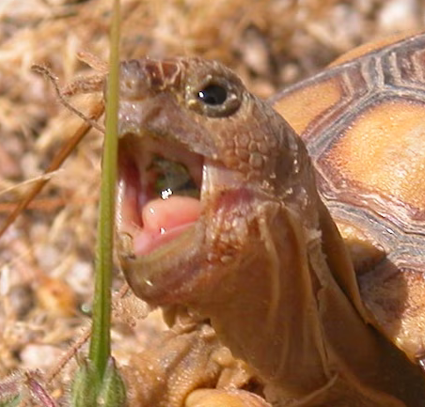
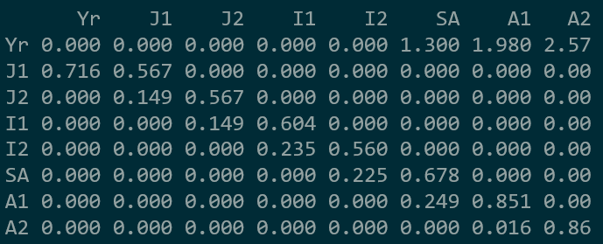
What’s a population matrix? (aka a transition matrix)
This is a population matrix for desert tortoise (Gopherus agassizzii). There are 8 life-stages are defined by age and carapace length.
Yr: Yearling (age 0-1)
J1: Juvenile 1 (<60 mm)
J2: Juvenile 2 (90-99mm)
I1: Immature 1 (100-139mm)
I2: Immature 2 (140-179mm)
SA: Subadult (180-207mm)
A1: Adult 1 (208-239mm)
A2: Adult 2 (>240mm)
Data source:
Doak, D., Kareiva, P., and Klepetka, B. (1994), Modeling population viability for the desert tortoise in the western Mojave Desert. Ecological Applications, Vol. 4, No. 3. pp 446-460

Slide 4
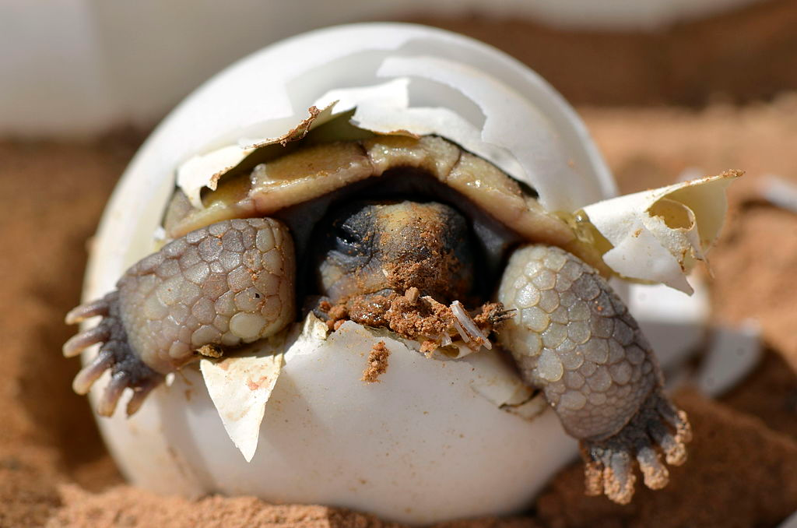
What’s a population matrix? (aka a transition matrix)
Each cell value represents the probability of an individual of that column’s life stage surviving to that row’s life stage. For example, a J1 has a probability 0.567 of surviving at its current life stage, or a probability of 0.149 of transitioning to J2. The remaining probability represents the probability of death.
0.149 + 0.567 = 0.716, so the probability of a J1 dying is 1 - 0.716 = 0.284

Slide 5
Deterministic projection
n_{t} = A n₀
Population size at time t Population Matrix Population vector at time 0
_{(# in each life-stage)}

Slide 6
project() function
Population Matrix Population vector at time 0 Time interval you want to (# in each life-stage) project to

Slide 7
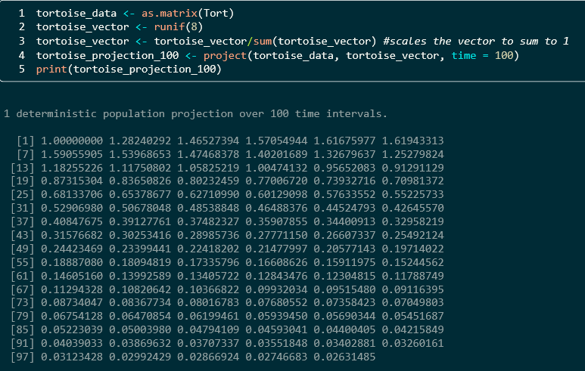
project() function
In the tortoise data, the actual number in each life-stage is not known. For demonstration purposes, we can just generate a random vector and scale it to 1.
This output is called a “Projection Object”. The numbers displayed are overall population sizes proportionate to the starting population size. Note that there are 101 numbers here because the starting population size is included.

Slide 8
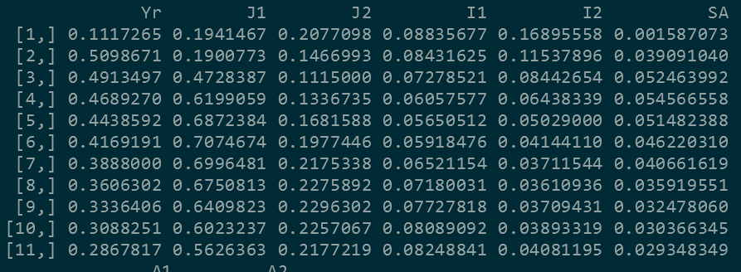
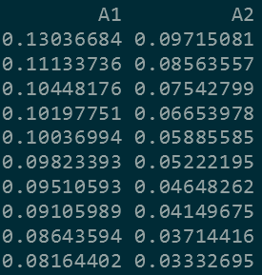
Projection Objects in R
Under the hood, the projection stores population numbers for each life-stage at each time-step.
The numbers on the right are the proportional population sizes of each life-stage in the first 10
time-steps, extracted from the overall projection on the left..

Slide 9
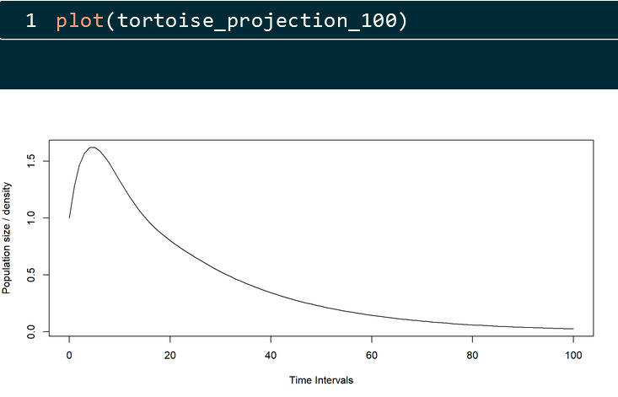

Projection Objects in R
popdemo also has a built-in plot() function which you can feed a projection object

Slide 10
That was a deterministic projection
What’s wrong with this model?

Slide 11
That was a deterministic projection
Assumes stability of transitions, mortality, and reproduction.
Does not account for stochastic events.
Essentially, it assumes that the transition matrix is static over time.

Slide 12
Stochastic Projection
n_{t+1}=A_{t}n_{t}
Population size at time t
Matrix at time t
Population vector at time t

Slide 13
Stochastic Projection
n_{t+1}=A_{t}n_{t}
Population size at time t
Matrix at time t
Population vector at time t
So how do we find A_{t} ?

Slide 14
project() function
Population Matrix Population vector at time 0 Time interval you want to (# in each life-stage) project to
Last time, we fed a single population matrix into the project() function. We can instead feed it a list of matrices. Each time it projects a new time-step, it will randomly select one of the matrices to use in calculating the next population size and vector. We also have the option to weight certain matrices higher or lower than the default selection probability. Why might we want to do that?

Slide 15
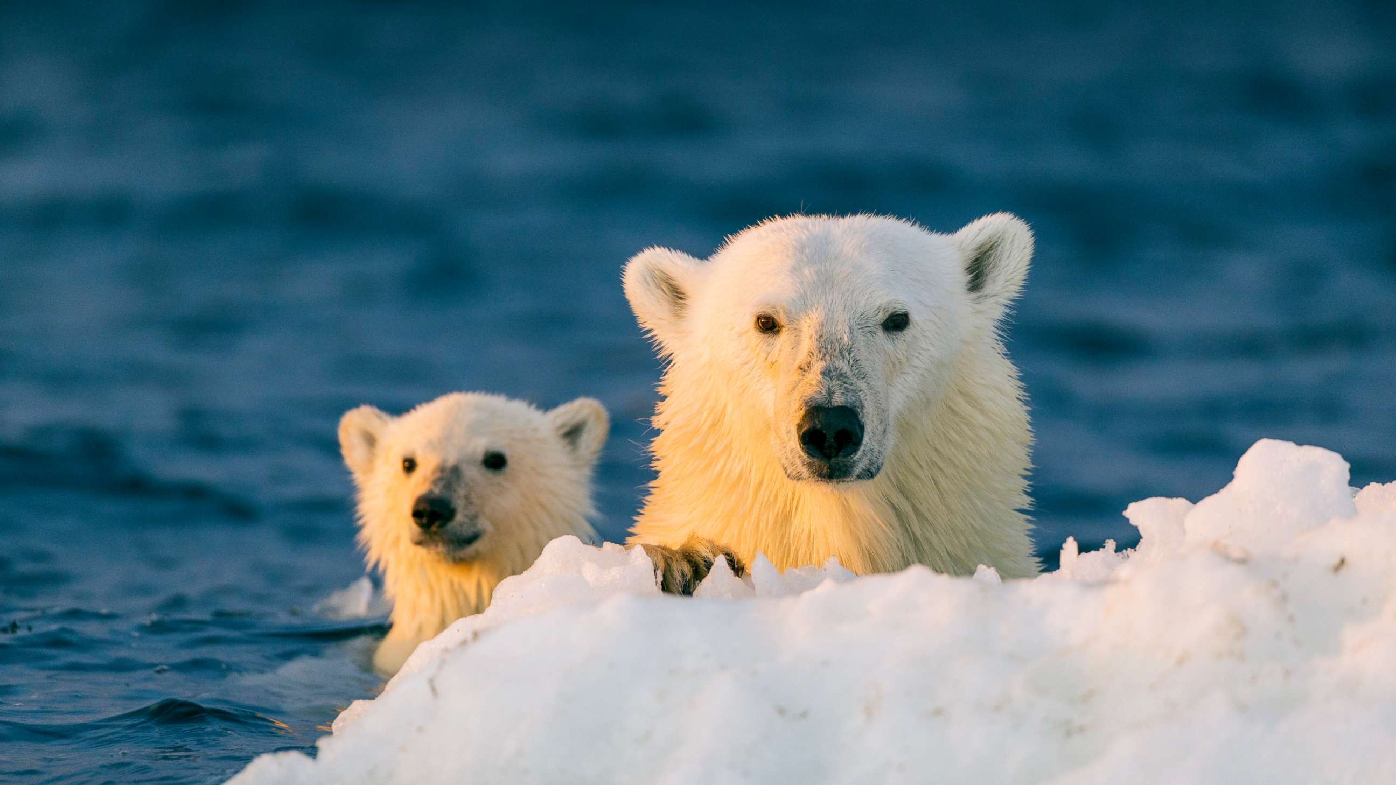
Stochastic Projection featuring Charismatic Megafauna!
Stochastic projections conducted in popdemo contributed to the listing of polar bears as threatened under the Endangered Species Act in 2008.
Hunter, C.M., Caswell, H., Runge, M.C., Regehr, E.V., Amstrup, S.C. and Stirling, I. (2010), Climate change threatens polar bear populations: a stochastic demographic analysis. Ecology, 91: 2883-2897. https://doi.org/10.1890/09-1641.1

Slide 16
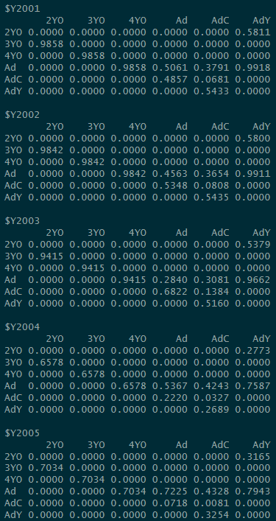
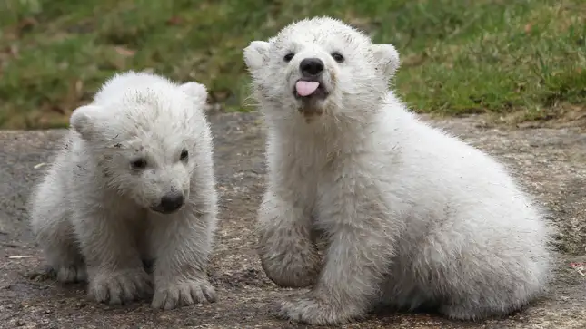
Stochastic Projection
The polar bear data from Hunter et al 2010 has population matrices for 5 years (2001 – 2005). We’ll feed this into the project() function as A.
Good sea ice years
Bad sea ice years
Note: In 2004 and 2005, sea ice conditions were bad enough to drive population decline.

Slide 17
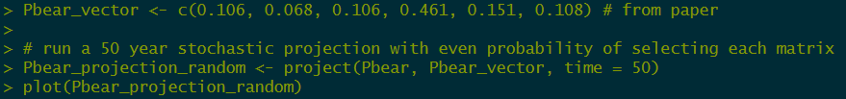
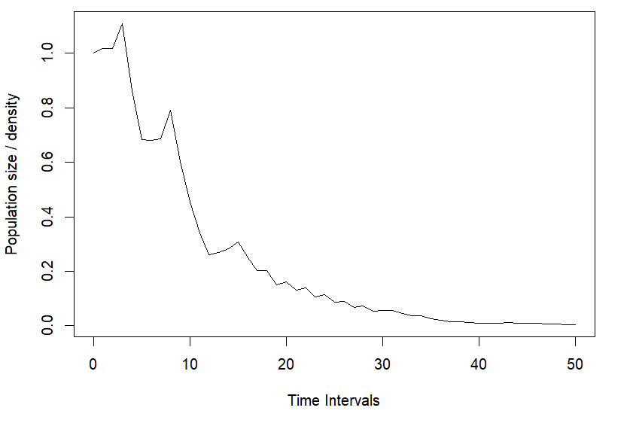
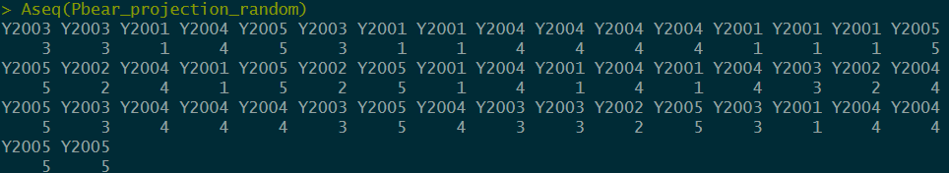
Stochastic Projection with project()
This usage of project() randomly selects a matrix out of the 5 provided each time it projects time-step. We can check its selections using the Aseq() function. We will later use this function to assign unequal probabilities to each matrix.

Slide 18
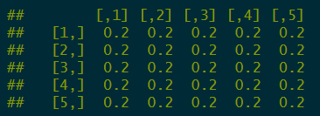

Stochastic Projection with project()
Under the hood, project() is generating and using a matrix of probabilities to select the population matrices each time-step.
This matrix works much the same way as a population matrix. Each cell value is the likelihood of moving from the column’s population matrix, to the row’s population matrix. In other words, given that we used matrix ‘x’ last time, what’s the probability of choosing matrix ‘y’
In this case, all of these likelihoods are equal because we didn’t specify otherwise.

Slide 19

Stochastic Projection with project()
But what if we don’t want the matrices to be equally likely to be selected?
In this case, we’re concerned about sea ice conditions, which were bad in 2004 and 2005, resulting in population decline.
With climate change, bad sea ice years will probably be more common. We want the projection to account for this.

Slide 20

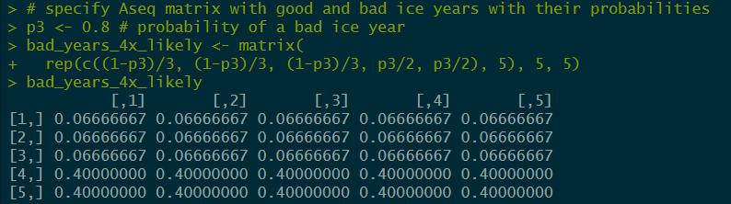
Stochastic Projection with project()
We can make our own matrix and call it into our projection using the Aseq() function.
For simplicity, let’s say that bad ice years are four times as likely as good ice years.

Slide 21
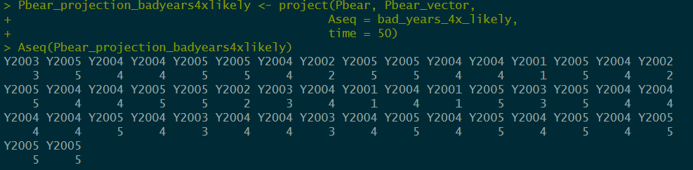
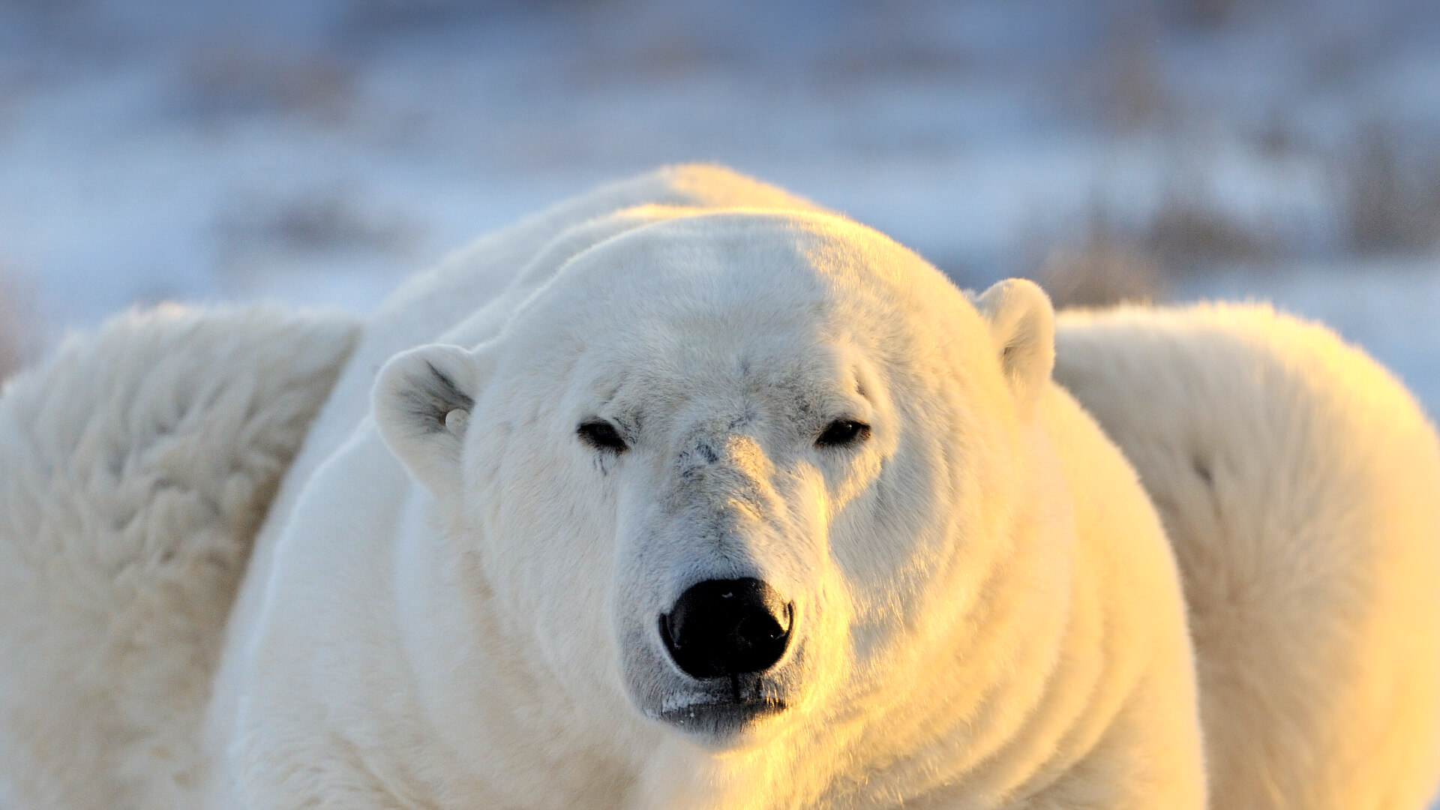
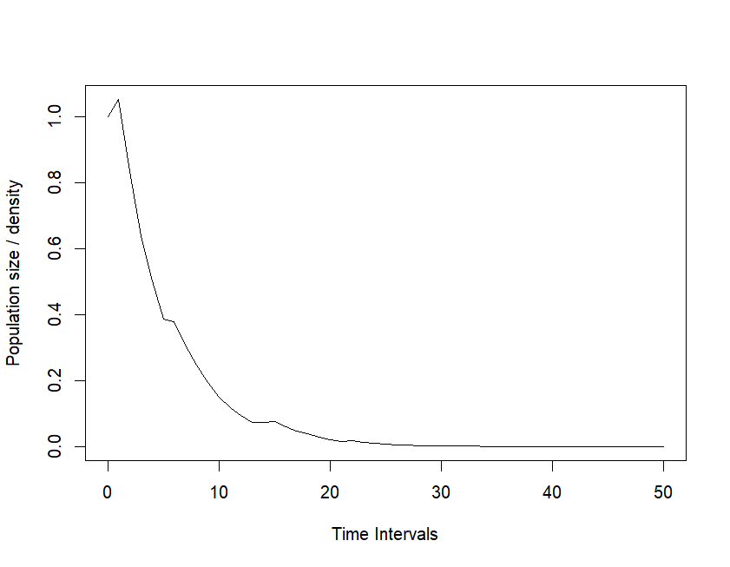
Stochastic Projection with project()
We can make our own matrix and call it into our projection using the Aseq() function.

Slide 22
Stochastic Projection with project()
Good & bad sea ice years equally likely
Bad sea ice years 4x more likely

Slide 23
Portfolio Assignment Task 1
When generating a probability matrix to feed into Aseq, we focused on the probability of bad ice year outcomes regardless of the current year’s ice status. We can imagine climatic scenarios where multiyear weather systems impact sea ice patterns.
Define a new matrix to feed into Aseq that takes the previous year’s sea ice status into account.
Make good years more likely if the previous year was good, and conversely make bad ice years more likely if the previous year was bad.
Define 2 new parameters which (a) describe the probability next year is a bad year given that this year was a good (use 20% likelihood), and (b) describe the probability next year is a bad year given that this year was a bad year (use 80% likelihood).

Slide 24
Portfolio Assignment Task 2
Task 1 still assumes that feedback loops in sea ice status are equal in each direction. Let’s consider that it’s more likely to switch from a good year to a bad year, versus from a bad year to a good year.
Define 2 new parameters which (a) describe the probability next year is a bad year given that this year was a good year (use 50% likelihood), and (b) describe the probability next year is a bad year given that this year was a bad year (use 80% likelihood again).

